Slide 1
Promoting Education & Leadership
Opportunities for our Global Majority Workforce
Jonah Atos
International Nurse Co-ordinator, WHSCT
Deepthi Roshan
Hospital at Night/Patient Flow Coordinator, SHSCT

Slide 2
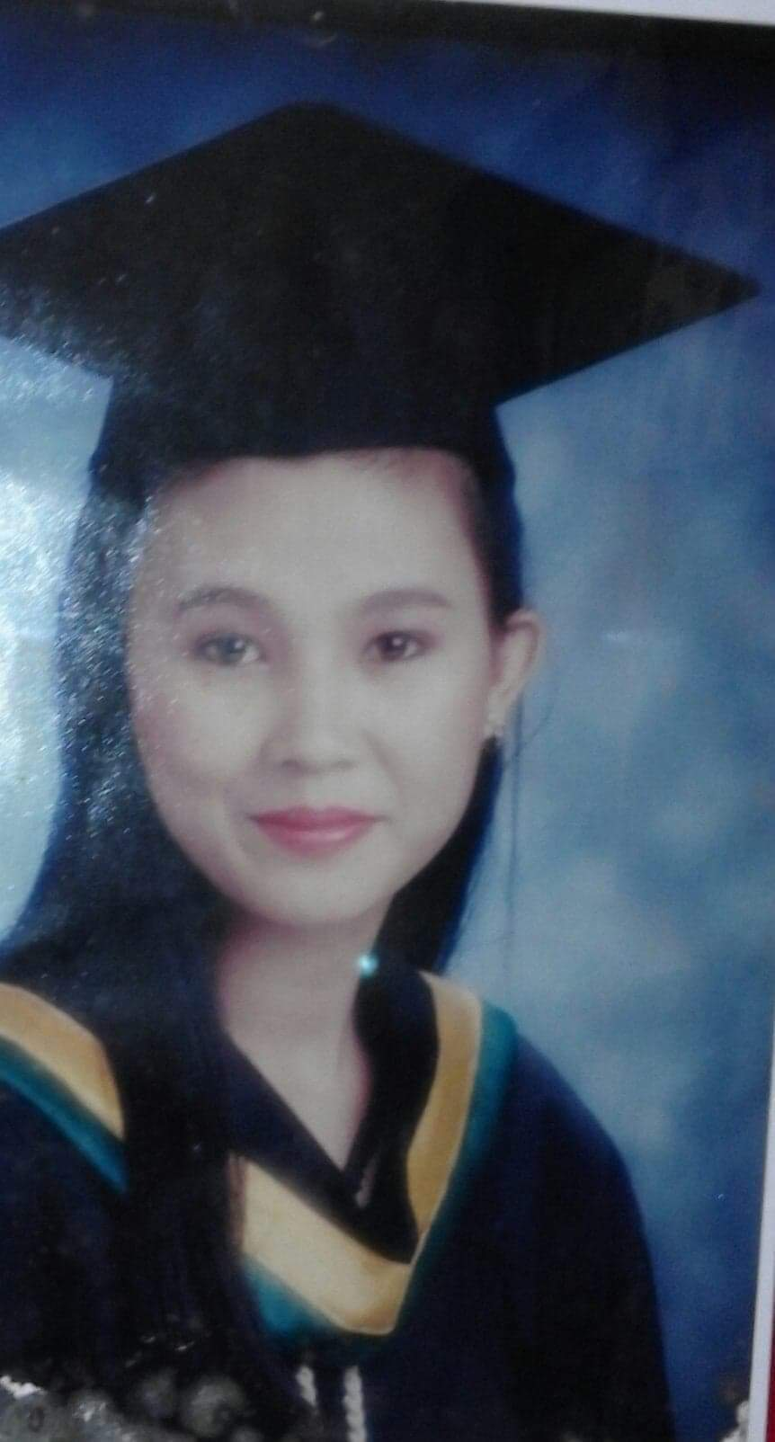
Before coming to Northern Ireland
Education
Nurse Licensure Exam
2 years Volunteering
Work experience
Notes:
Jonah :

Slide 3

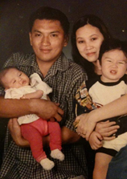
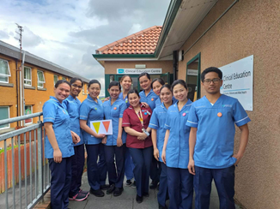
Top 3 reasons coming to Northern Ireland
Professional
Financial/family
Social
Notes:
Jonah :

Slide 4






Application and Registration process

Slide 5
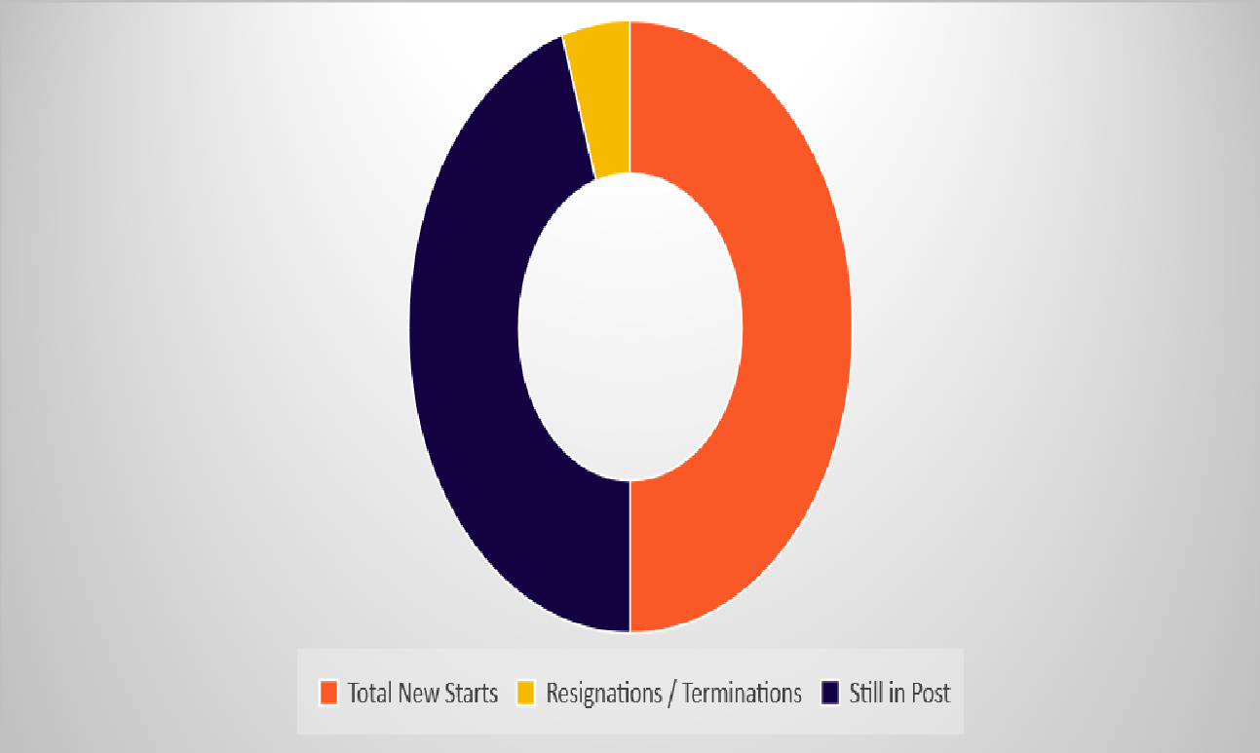

HSCNI International Nursing Recruitment Overview
From 2016- 30th June 2025
190
1707
1897
91% Retention Rate

Slide 6

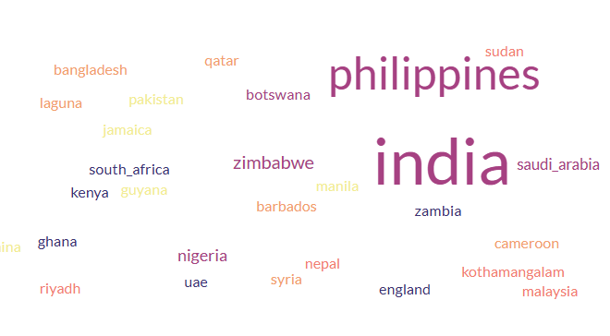
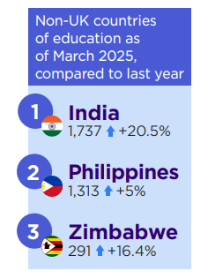
Country of Origin
NMC Register Data Report (March 2025) with an address in Northern Ireland

Slide 7
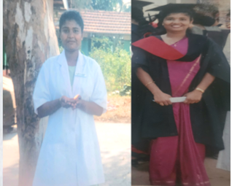

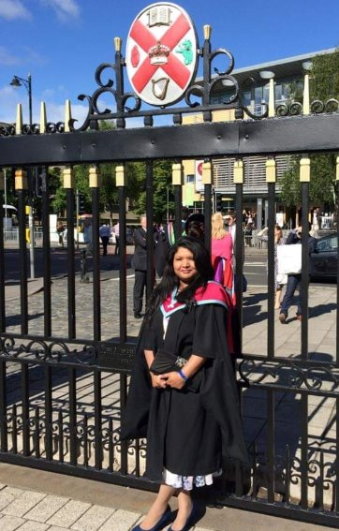
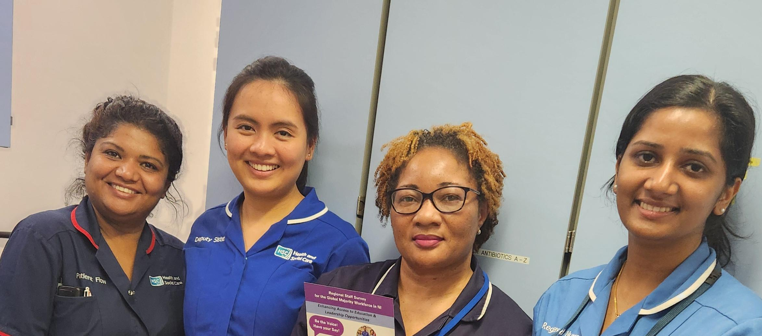

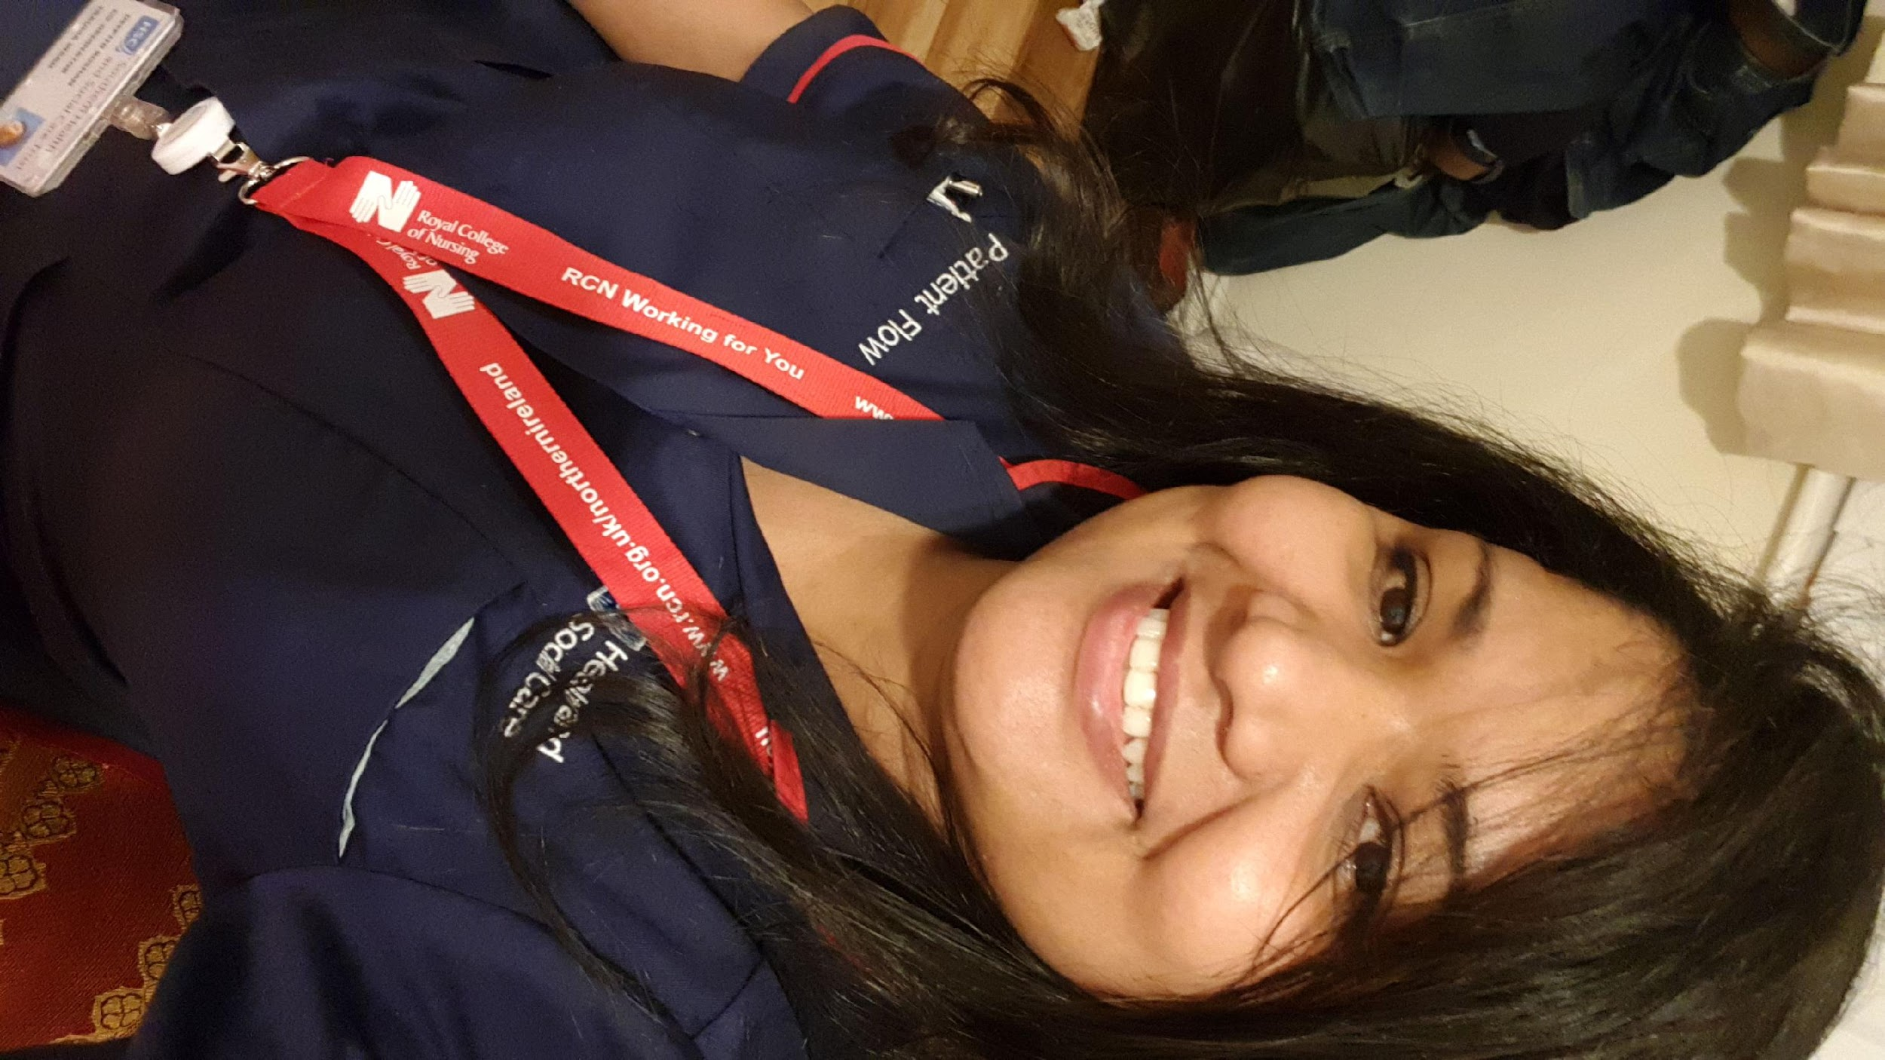
My Journey as a Nurse

Slide 8


Access to education and leadership opportunities staff survey

Slide 9





Staff Survey Results
1086
Responses from the Global Majority
236
Responses from those who are Ethnically White
Nurse/
Midwife
Support Worker
Nurse
Midwife
AHP
920
3
4
17
142

Slide 10
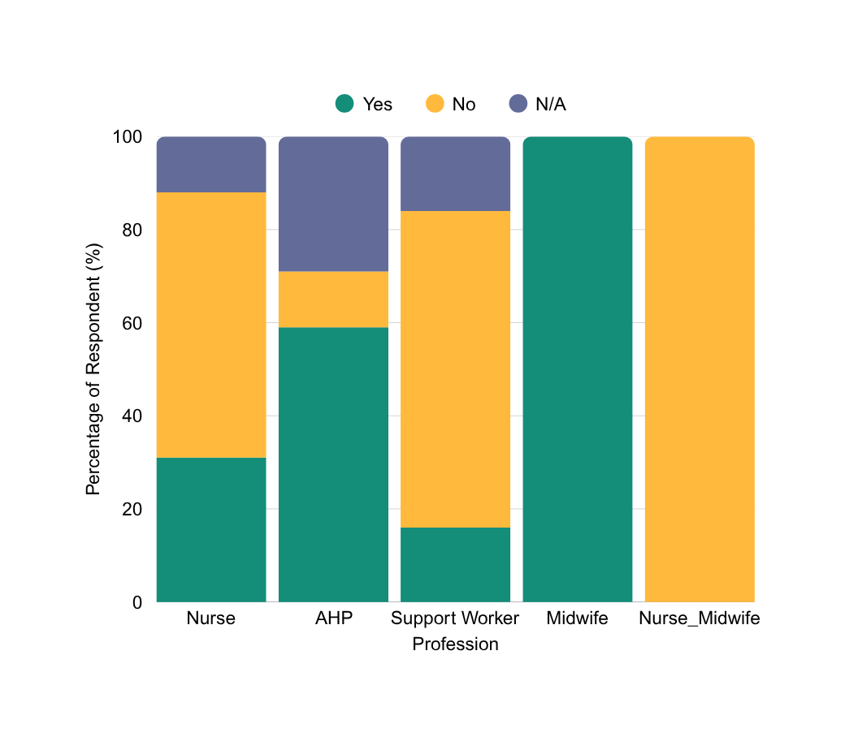
Professional Comparison
Have you had any opportunities for promotion since 2019?
 | Yes | No | N/A
Nurse | 31% | 57% | 12%
AHP | 59% | 12% | 29%
Support Worker | 16% | 68% | 16%
Midwife | 100% | 0% | 0%
Nurse/Midwife | 0% | 100% | 0%

Slide 11
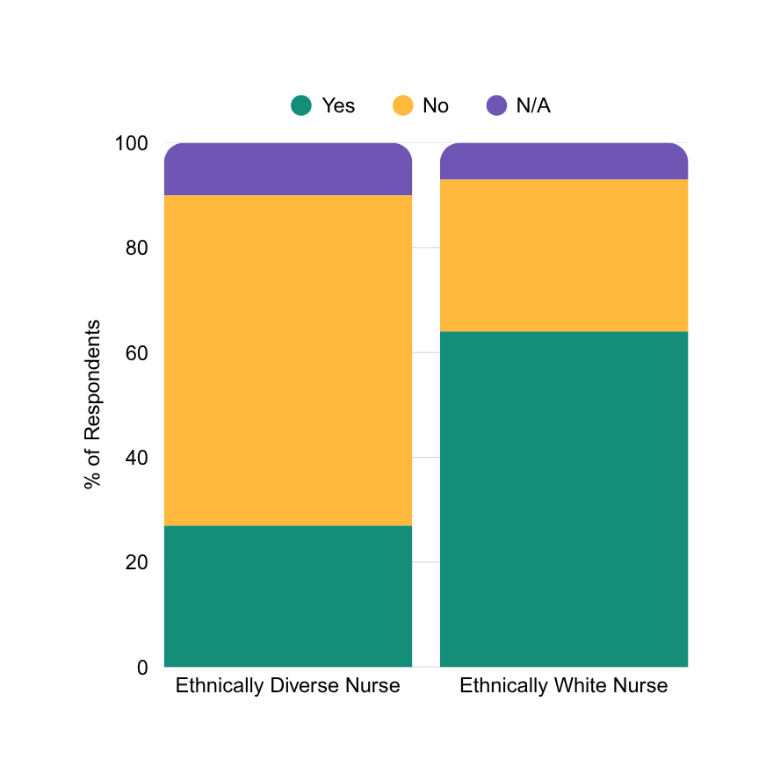
Ethnically Diverse vs Ethnically White Nurses
Have you had opportunities for promotion since April 2019?
Challenges faced- Ethnically Diverse Nurses:
  Employee and Line Manager awareness of qualifications and/or experience required and the manner in which it can be obtained
  Lack of recognition of previous experience within the Job Descriptions (criteria)
  Need for Top-Up Degree

Slide 12

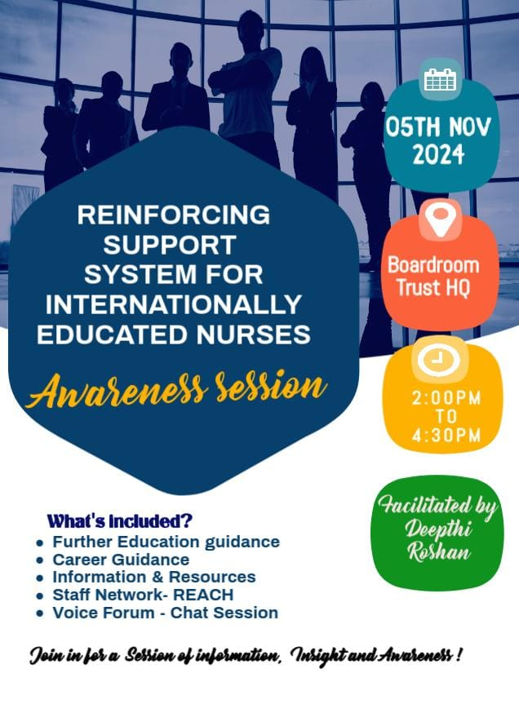
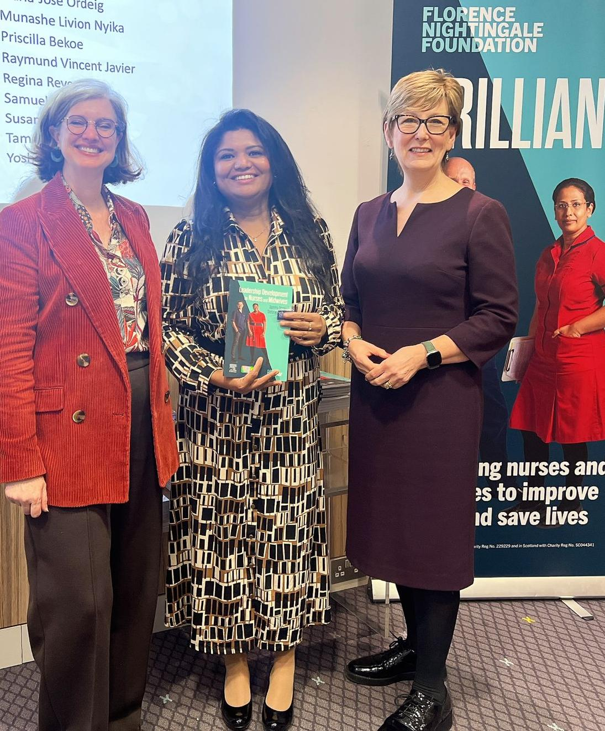
Leadership opportunity

Slide 13


A Glimpse into my Project- Empowering Internationally Educated Nurses: Enhancing Support, Engagement, and Inclusivity at the workplace
Objective:
Address inequities and systemic barriers faced by IENs through
targeted strategies.
Key Actions and Outcomes:
Survey (pre/post awareness sessions) : Engaged 71 IENs
VOICE Forum
Awareness sessions

Slide 14
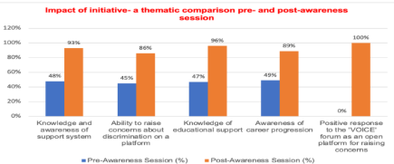
Impact of the Project
Empowered IENs by addressing concerns and fostering inclusivity. Improved workplace satisfaction and awareness of support system at workplace for IENs.
Piloted sessions enhanced understanding of resources, with over 20% positive feedback.

Slide 15
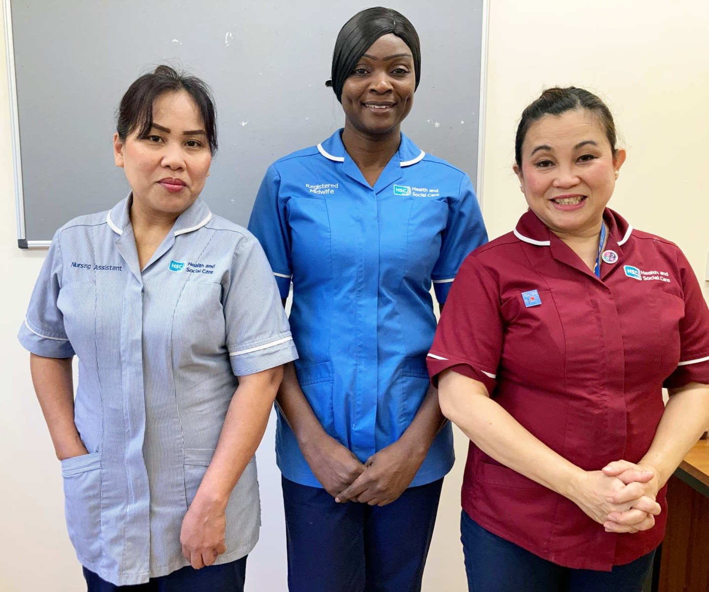

In summary: Challenges faced by global majority workforce in professional development
Education not recognised
Not eligible to apply for senior post
Not having equitable access to education
Slow career progression
Post registration experience not recognised
Visa restrictions to study

Slide 16
What can we do? – Access to education and leadership opportunities
Career pathway/career clinics
Empowering Managers
Information Hub
CHAT/Forums
Interviewing preparation/
Interview panel/Review JD
Top up degrees
UK ENIC
Leadership programme
FNF

Slide 17
Statement of Comparability
The UK ENIC site is useful for those needing to check the comparability of education.
Read here about UKENIC
UK ENIC Process
https://www.enic.org.uk/Default.aspx

Slide 18
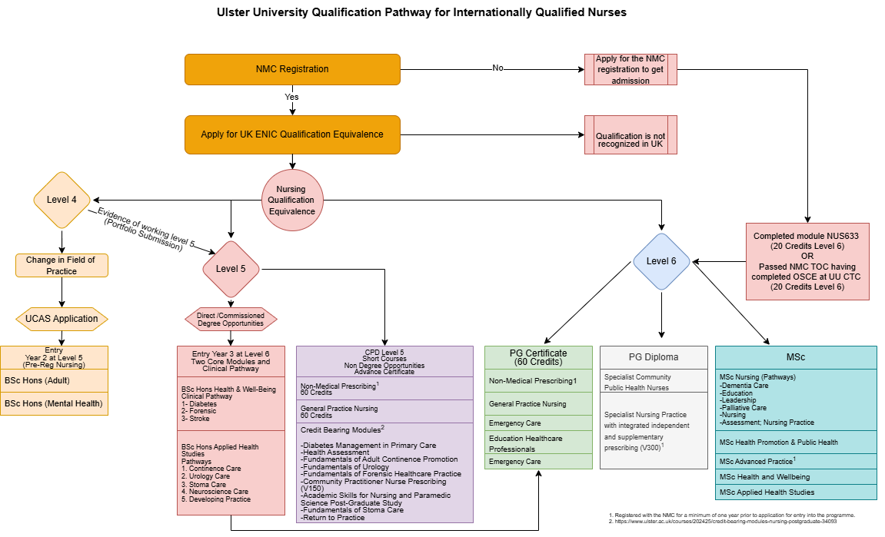
Pathway to Ulster University Admission for Internationally Educated Nurses

Slide 19
The 4 Pillars of NHS Staff Retention Kit
Creating a strong foundation
Building Belonging
Making new recruits feel welcome
Maximising personal and professional growth

Slide 20
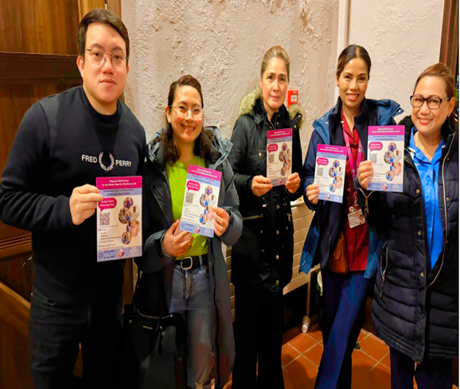

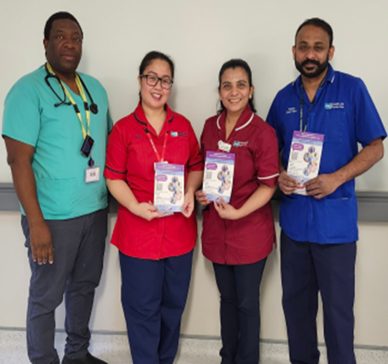
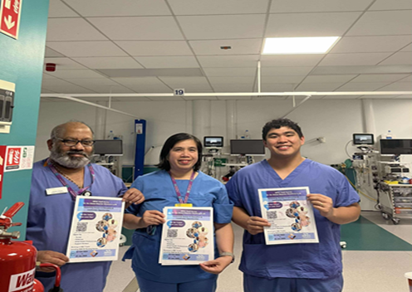
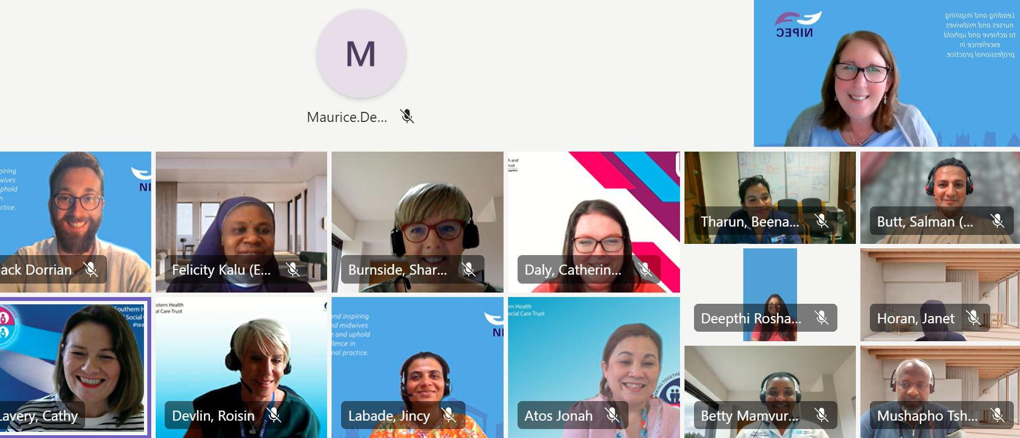
Thank you!

