Slide 1
Professional Update
2 December 2025
NIPEC Conference
Professor Paula Holt MBE DL
Paula McLaren
Senior Advisers

Slide 2

Updates on programme of work:
Practice Learning Review
Advanced Practice
The Code
Revalidation

Slide 3

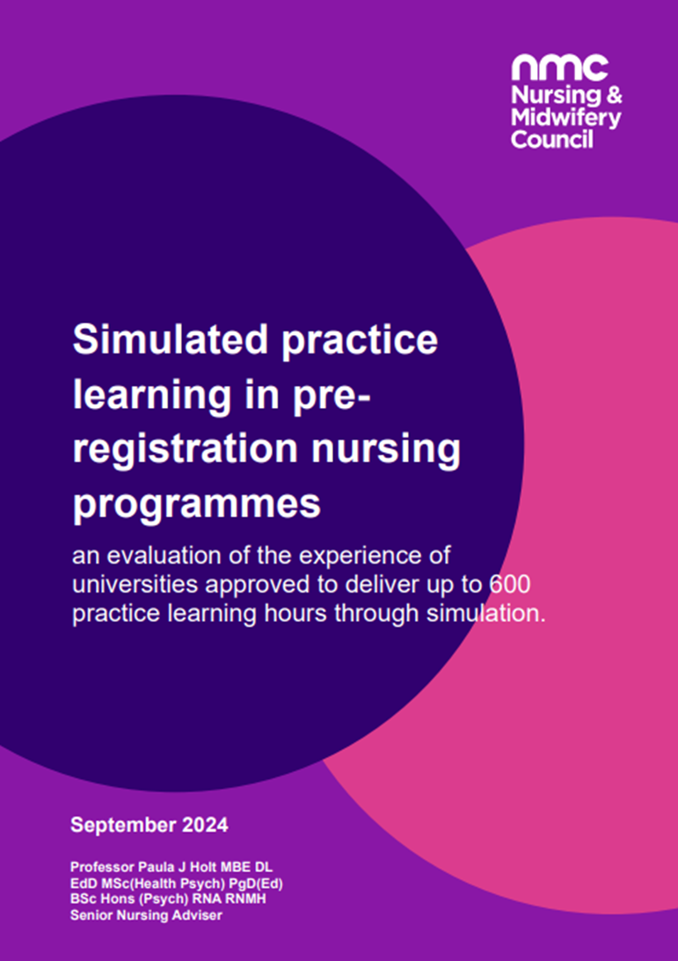
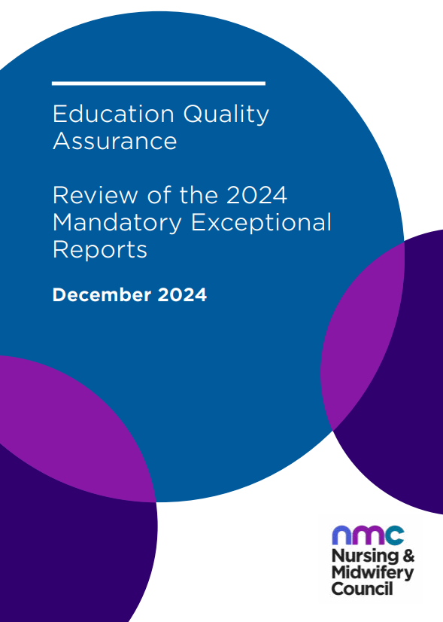
Practice Learning review
Community of interest: sign up to our community of interest
Practice learning in nursing and midwifery education
Evaluation of simulated practice learning
2024 Mandatory Exceptional Reporting

Slide 4
Person-centred, holistic care in practice?
Being presented with the list of proficiencies, examinations, tally of births and practice hours can be overwhelming bringing heightened anxiety for students and supervisors
‘Taskification’
A factor reported from supervisors and students – this was where the proficiencies were seen as a checklist to work through
Pressure to work through a list leads to deprioritising elements such as continuity of care for service users – a concern that this undermines complex care
Challenge to balance a wide breadth of shallow experiences against sufficient time and repetition of skills to deliver person centred care
What is driving this…
Standards of proficiency / skills annexes? Time?
Practice assessment documentation?

Slide 5





Variance in student practice learning experience influenced by
Misinterpretation of standards
Differing ways of implementing the standards
Shifting context in health and social care
Taskification
Practice supervisors and practice assessors

Slide 6



EDI is a consistent challenge across practice learning experience - for example
Before placements – e.g. failure to adopt reasonable adjustments
During placements – e.g. bias and discrimination
After placements – e.g. impact on representation and employment
These factors impact on nurses, midwives and nursing associates – due to race, ethnicity, disability, socio demographic status

Slide 7

So where are we now?
Considering public consultation Q4 2025/26:
We will develop a statement of intent to ensure that a systematic approach is taken to addressing concerns regarding cultural awareness, racism and unconscious bias that is aligned the NMC corporate position
Position statement on practice learning
Case studies / best practice and innovation
Supporting information / guidance to clarify some standards
Review and update web pages / App
Practice learning hours?

Slide 8
Review of AP

Slide 9

Phase 1: In March 2024, Council agreed that…..
Additional regulation of advanced practice is needed for both nursing and midwifery professionals and agree to proceed to phase two of the AP review
Phase 2 – develop additional regulation

Slide 10
Phase 2 – purpose
The NMC will establish a robust, multi-phase regulatory
framework for advanced practice that enhances public
protection, promotes consistency, and builds confidence in AP professionals across all four UK nations
The purpose of this is to improve regulatory oversight of the
growing workforce of nurses and midwives working at an advanced level across the UK, thus ensuring safe, effective and publicly accountable practice.
Current issues:
Integrity of the register
Public protection risk
Inconsistent standards
No single solution
Notes:
Integrity of the Register: The NMC does not know which registrants are practising at an AP level, nor can members of the public or employers easily identify them on the register.
Inconsistent standards: There is significant variation in how AP is defined, implemented, and governed across the four UK nations and sectors
Public protection risk: Independent research by the Nuffield Trust and internal analysis (2023–24) found latent risks to public safety due to the absence of standardised regulation for AP roles
No single solution: Council recognised in March 2024 that multiple regulatory tools are needed to address these risks—a multi-pronged strategy is essential

Slide 11



The Principles for Advanced Practice
Set out what is expected for safe and effective advanced level practice to thrive by:
Underpinning and supporting effective governance for advanced level practice for nurses and midwives
Supporting development, maintenance and transformation of environments in which advanced level practice is delivered
Supporting patient safety and public protection
Notes:
How developed:
Alignment and mapping to existing four nation UK frameworks
Analysis of international policy context
Extensive public engagement including development of public definition
Extensive engagement with key stakeholders
Consideration of relevant frameworks
Mapping to current health and social care reports drawing upon research and evidence-informed practice

Slide 12



The Principles will support:
They will help patients and people who use services to understand the role of an advanced level nurse or midwife, including a definition that is clear to the public
The Public
They will help professionals with consistent, high quality safe and effective delivery of care by setting clear expectations for advanced level nursing and midwifery practice
Professionals
They will help employers to develop and sustain systems in which advanced practice can thrive – for example in workforce, education, support and supervision, CPD and governance planning
Employers

Slide 13

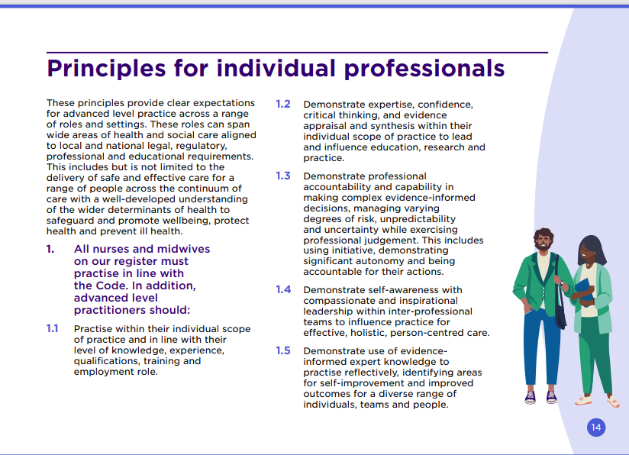
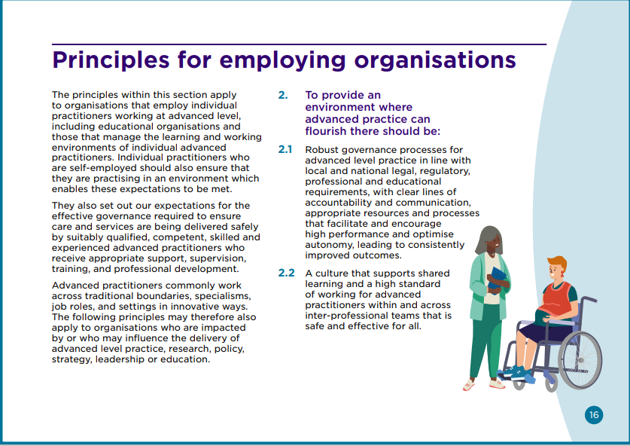
Structure of the Principles
Notes:
Clear expectations across range of roles and settings, across the four nations of the UK
All those who employ APs – HEIs, self-employed, and effective governance expectations (working across the four pillars, support, supervision, professional development and training)

Slide 14

Implementation of the Principles
We’d encourage all organisations to become familiar with and use the principles to review their processes and governance around advanced level practice
This will help you prepare for additional regulation when it is launched – ie all workstreams completed and approved by the Council
The principles aim to be supportive and encourage flexibility for individual organisations
When we talk about advanced practice we’re referring to a level of practice, so this is an opportunity to think about your current workforce in higher level roles

Slide 15

Early adopters
What’s working well?
What feedback have you had from stakeholders?
What are the challenges?
We’ll evaluate and publish a report to help:
Demonstrate the impact of the principles
Provide additional evidence for the remainder of the review
Influence and encourage others to implement through shared learning

Slide 16
Additional regulation of Advanced Practice
Fully delivered once all of the parts have been finalised, agreed by Council and implemented
Principles for Advanced Practice
(launched 10 June 2025)
Proportionate transition process for existing AP’s (2025 to Phase 3)
Standards of proficiency and associated programme standards + quality assurance of education institutions (2027/28)
AP considerations within review of Code and revalidation (2025/26)
THEN – proceed to Phase 3 – implementation of standards and transition

Slide 17
Review of the Code and Revalidation

Slide 18



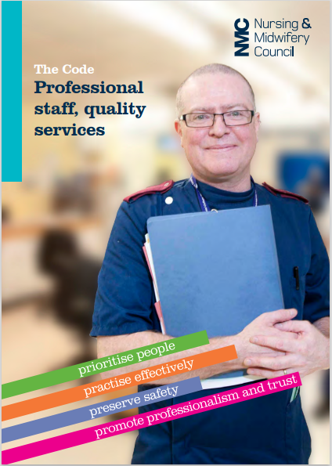

The Code – what it means for different stakeholders
Professionals
The public
Employers
Students
Notes:
The Code was published in 2015 and updated in 2018 with the addition of nursing associates in England
– the sector has changed, the way professionals work has changed, technology has developed, roles have evolved

Slide 19


Context
Technology
Population profile
Public Inquiries
Workforce
The pandemic
Health & social care landscape
Professionals facing
numerous challenges
in the current healthcare
landscape
Notes:
Technology: rapid growth in technology, artificial intelligence, digital transformation (impact on health care and education), data security issues, digital exclusion of some, workforce skills not in line with ambition
Health and social care landscape: Shifting government priorities, how care is delivered, shift of focus on sustainability and environmental issues, underfunded and fragmented social care system
The pandemic: long waiting lists, tired burnt-out staff, wellbeing and mental health issues, access to care, reduced vaccination rates
Population profile: ongoing challenges in addressing health and social inequalities, ageing population and increased demand on health and social care, shifting societal expectations
Public inquiries: Thirlwall, Leng, maternity services – impact on ;public trust and confidence in health and social care professionals
Workforce: reduction in numbers of qualified health and social care professionals (care delivery but also supporting education and training)– training, attrition, retention all issues, service pressures, poor morale, early retirement, multiprofessional, working and learning, academic workforce depletion, ongoing disputes over pay, ageing workforce, growth of internationally educated workforce

Slide 20

Vision Statement
Our new Code will be evidence-based and future-focussed, reflecting contemporary practice, our ambitions on equality, diversity and inclusion, ensuring it reflects the breadth of the register, our remit as a regulator and is based on feedback provided by a range of stakeholder voices.

Slide 21




Four country plans
Prevention of ill health
Enabling technology – digitalisation and Artificial Intelligence
Shift of care from hospital to community – closer to home/neighbourhood teams
Recognise unique population needs
Support workforce growth – interprofessional learning and working
Notes:
Wellbeing and mental health services, particularly for children, reduce waiting times
Nurses, midwives and nursing associates – as leaders and as those who deliver care – have a hugely important role to play in all of these things

Slide 22
Key points for the review
Four country context
Three professions – across nursing and midwifery
Addition of nursing associate role in England
Updated education standards and proficiencies
NMC as a regulator and NMC as an organisation
Learnings from the past 10 years
Future focus
Breadth of practice, settings, roles
Population profile and demographics
Technology and digitalisation
Notes:
Future focus

Slide 23

Our approach
  Clear objectives for embedding authentic equality, diversity and inclusion
  Culture transformation with clear links to regulatory fairness
  Co-production – involving members of the public and patients, and professionals on the register promoting a culture of openness and honesty
  Co-design of outcome focused standards, guidance and other deliverables – actively engaging, respecting and applying multiple perspectives to prioritise outcomes
  Communication and engagement that is participatory, inclusive, open and transparent
  Consensus building and decision making that is underpinned by evidence and expert perspectives that drives validity and rigour of approach

Slide 24
The Code also includes underpinning guidance
REVIEW CREATE COLLABORATE KEEP AS IS
Existing guidance
Raising concerns
Professional duty of candour
Social media
Potential areas for guidance development
Delegation
Prescribing practice
Professional boundaries
Safeguarding
Sustainability
Student focussed Code
Other products to develop like supporting information, infographics, animations

Slide 25

Areas of Focus
Areas to strengthen:
New areas:
Prescribing
Delegation
Social media usage
Behaviour outside of professional practice
Raising concerns
Culture and working environments
Bias, stigma, discrimination and EDI
Use of technology and AI
Students and the Code
Sustainability and planetary health
Considerations for Advanced level practitioners – four pillars, scope of practice
Notes:
Code as a professional reflective tool, not just for fitness to practice

Slide 26




Your views
Are there things that you think we’ve not mentioned that we should be focussing on in the modernisation of the Code?
What are the things that you like about the current Code that should be included in the modernised Code?
What do you think the NMC’s role is in promoting planetary health and sustainable practice?
Are there things that we should be focussing on for those in advanced level roles?

Slide 27
Revalidation Review

Slide 28

What is revalidation?
We want to make sure that professionals on our register are continually keeping their skills and knowledge up-to-date for practising safely throughout their career
Every three years, to renew their registration with the NMC, all professionals on our register (wherever they qualified and wherever they now practise) need to undertake several activities by revalidating

Slide 29







Overview of revalidation requirements
 | Requirements | How to meet the requirements
 | Practice hours | 450 practice hours (900 for dual registration)
 | Continuing professional development | 35 hours of continuing professional development (CPD). 20 hours must have included participatory learning
 | Practice-related feedback | Five pieces of practice-related feedback
 | Written reflective accounts | Five written reflective accounts on CPD and/or practice-related feedback and/or an event or experience in your practice, and how this is relevant to the Code
 | Reflective discussion | Reflective discussion with another NMC-registered nurse, midwife or nursing associate, covering the five written reflective accounts
 | Health and character | Health and character declaration, covering any cautions, convictions or determinations
 | Professional indemnity arrangement | Declaration of appropriate cover under an indemnity arrangement
 | Confirmation | Demonstration to an appropriate person that have met the revalidation requirements.

Slide 30





Revalidation aims to:
Raise awareness of the Code
Encourage professionals to stay up to date
Encourage sharing, reflection and improvement
Encourage professionals to engage in professional networks and discussions
Strengthen public confidence in the professions
Revalidation should lead to improved practice and public protection benefits

Slide 31




Why are we reviewing revalidation?
Revalidation was introduced in 2016
Advances in technology and its use in practice
Changing role of professionals, including advanced practice and leadership roles
Systemic issues, incl: staff shortages, long wait times, poor cultural sensitivity
Learning from public inquiries
Notes:
We introduced revalidation in 2016
Since then we’ve collected lots of evidence about people’s experiences of the process and its impact on practice.

Slide 32
Revalidation aims to:
Raise awareness of the Code
Encourage professionals to stay up to date
Encourage sharing, reflection and improvement
Encourage professionals to engage in professional networks and discussions
Strengthen public confidence in the professions
Revalidation should lead to improved practice and public protection benefits

Slide 33
Timelines for Code and Revalidation reviews
Options co-development findings to Council
Public consultation
Council approval and launch
New Code / revalidation process go live
Evidence gathering / stakeholder engagement
Summer 2025 – Spring 2026
Spring 2026
Sept – Nov 2026
October 2027
April 2028

Slide 34


Review of the Code and Revalidation
Please scan to complete our survey – this is your opportunity to shape the future of both of these

Slide 35




Stay in touch
Have you signed up for our regular newsletter yet?
You can do it now: nmc.org.uk/newsletters
For enquiries contact our dedicated inboxes:
Any standards related enquiries: educationandstandards@nmc-uk.org
If you trained in the UK or are registered with us: UKenquiries@nmc-uk.org
If you trained outside the UK: Contact us about overseas registration
@nmcnews
facebook.com/nmcuk
@nmcnews
linkedin.com/company/the-nursing-and-midwifery-council

Slide 36
Thank you

