Slide 1
AI in Healthcare & its Impact on Practice
Stephen Beattie
Acting Director of Strategic Planning
and Customer Engagement

Slide 2





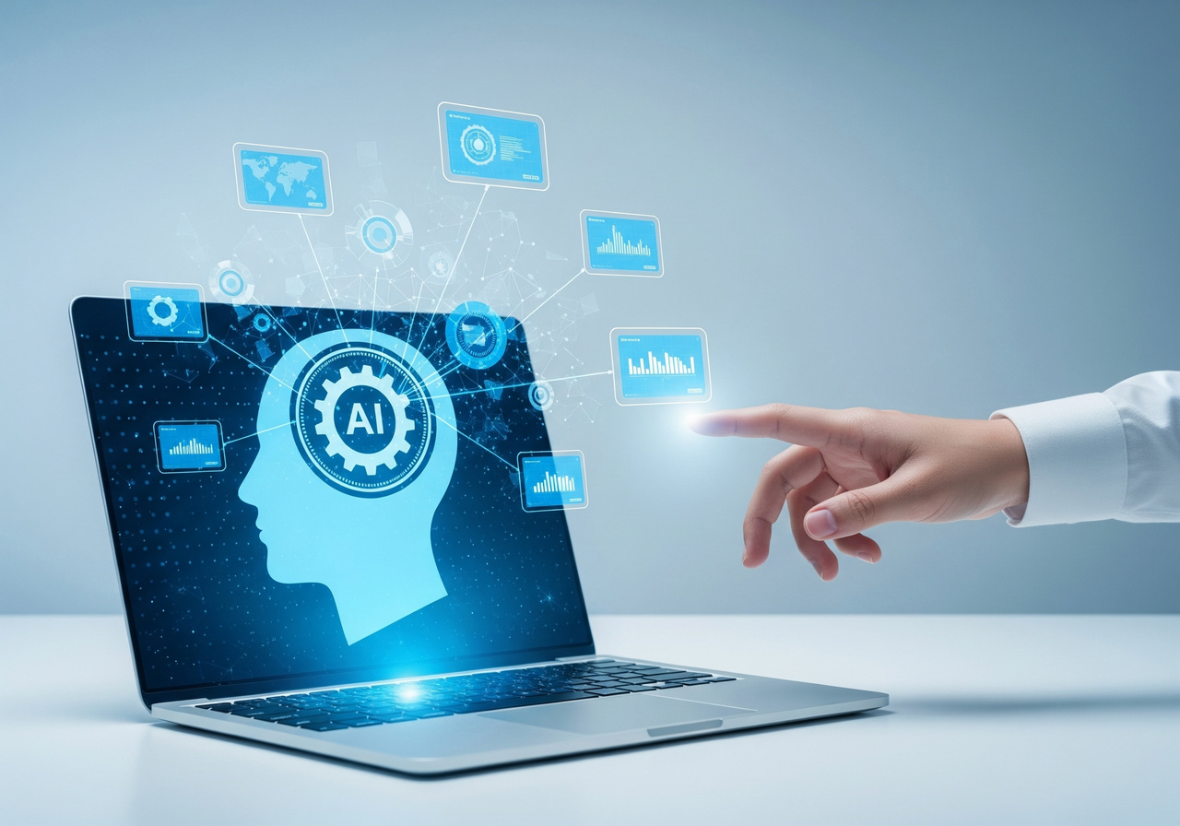



AI in Healthcare &
its Impact on Practice
Stephen Beattie
Acting Director of Strategic Planning and Customer Engagement, BSO

Slide 3
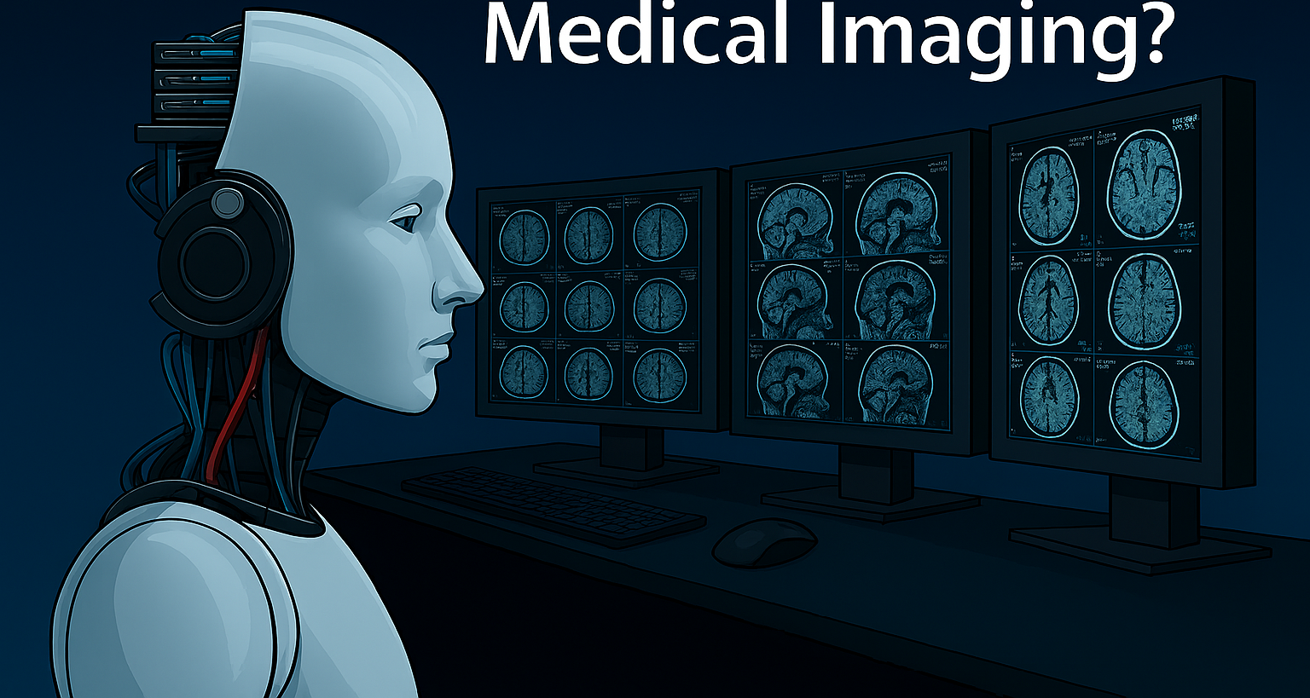
What is Artificial Intelligence?
AI refers to technologies that mimic human cognitive functions like learning, reasoning, and decision-making.
Key types:
- Machine Learning: Learns from data to make predictions.
- Generative AI: Creates content (text, images, etc.).
- Natural Language Processing: Understands and generates human language.

Slide 4
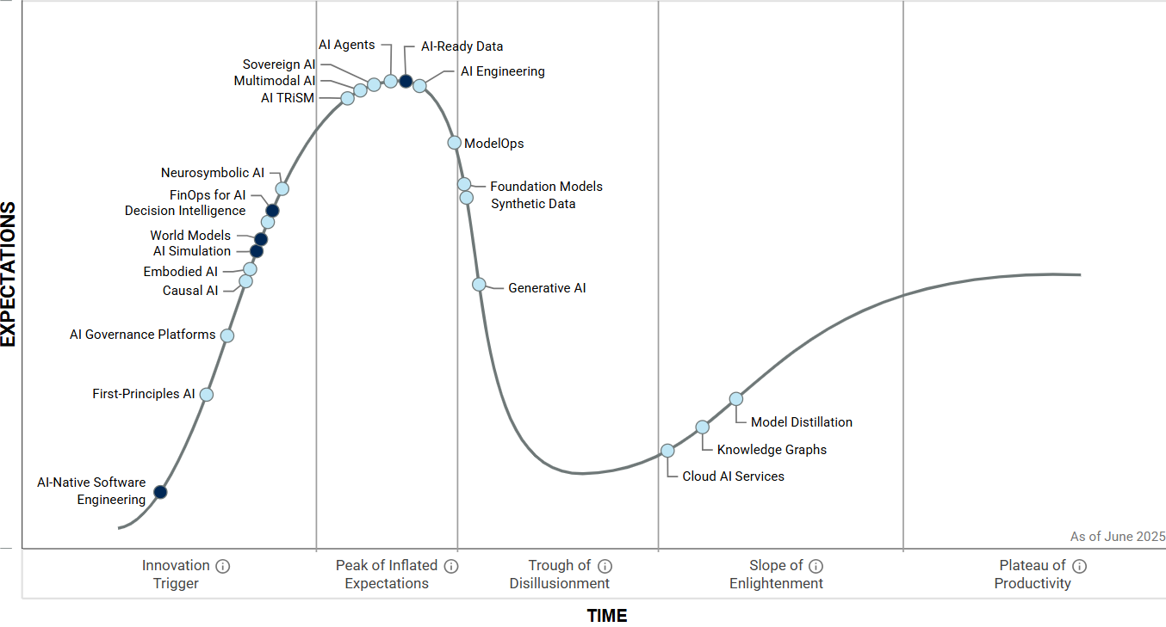

Gartner Hype Cycle for AI

Slide 5

How is AI Being Used in Healthcare? (beyond the hype)
Scheduling: Automates appointment booking.
Documentation: Transcribes and summarizes clinical notes [ambient scribing].
Diagnostics: Assists in interpreting imaging and lab results.
Treatment Planning: Suggests evidence-based care plans.
Predictive Analytics: Forecasts patient deterioration or discharge needs.
Placement & Rota Scheduling: AI tools optimize student nurse placements.
Telehealth Support: AI chatbots assist with triage and patient queries
Notes:
– Healthcare organisation and administration
– Diagnosis and treatment (clinical decision making and service delivery)
– Population health and prevention
– Biomedical research

Slide 6
How is AI Being Used in Healthcare? (beyond the hype)
Addenbrooke’s Hospital: Microsoft InnerEye for prostate cancer imaging.
HeartFlow: AI-generated 3D heart models for coronary diagnosis.
C the Signs App: Used by nurses to identify cancer risk during consultations.
DeepMind & Moorfields Eye Hospital: AI for rapid eye disease diagnosis.
HSCNI - NIPACS+ Boneview
HSCNI - Encompass / EPIC Ambient Voice; Noting

Slide 7
How is AI Being Used in Healthcare?
AI-Assisted Pregnancy Scans
Example: AI tools are being trialled to assist with 20-week anomaly scans, making them faster and just as accurate as traditional methods.
Impact: Frees up sonographers and midwives for more mother centred care.
Citation: MDPI Scoping Review on AI in Midwifery [mdpi.com]

Slide 8
How is AI Being Used in Healthcare?
AI-Driven Risk Assessments
Example: AI can generate live falls risk assessments using data from Electronic Patient Records (EPRs), reducing the documentation burden for nurses and midwives.
Impact: Supports real-time decision-making and improves patient safety.
Citation: Digital Health: AI and Data in Nursing and Midwifery [digitalhealth.net]

Slide 9
How is AI Being Used in Healthcare?
AI-Driven CTG (Cardiotocography) Decision Support
Example: AI tools assist midwives in interpreting foetal heart rate patterns during labour, supporting safer and more accurate clinical decisions.
Impact: Enhances confidence and accuracy, especially in high-risk births.
Citation: MDPI Scoping Review on AI in Midwifery [mdpi.com]
Early Warning Systems for Maternity Safety
Example: AI scans NHS data to flag risks such as stillbirth or neonatal death in real time, enabling earlier interventions.
Impact: Improves safety and outcomes in maternity care.
Citation: NHS England AI Case Studies [digital.nhs.uk]

Slide 10
How is AI Being Used in Healthcare?
AI in Midwifery Education
Example: AI-powered virtual patients and personalised learning tools are being used to enhance clinical education for nurses & midwives.
Impact: Reduces training errors and supports ongoing professional development.
Citation: MDPI Scoping Review on AI in Midwifery [mdpi.com]
Predictive Analytics for Maternal Health
Example: AI models predict complications such as preeclampsia or preterm birth, supporting proactive care planning.
Impact: Enables earlier interventions and better resource allocation.
Citation: Integration of AI in Midwifery Care: A Systematic Review [oaskpublishers.com]

Slide 11
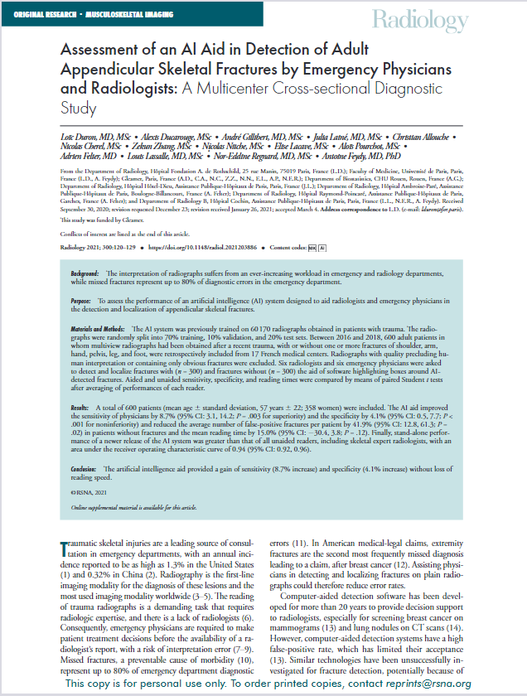
2021 Paper
NHSCT Audit
600 patients 17 centres
Excluded obvious fractures
ED sensitivity improved 61.3% - 74.3%
  13% increase
Radiology sensitivity 80.2% - 84.6%
  4.3 % increase
725 patients 3 centres (single Trust)
ED sensitivity improved 79.8% - 94.3%
  14.5% increase
Radiology sensitivity 89.1% - 94.4%
  5.3% increase

Slide 12
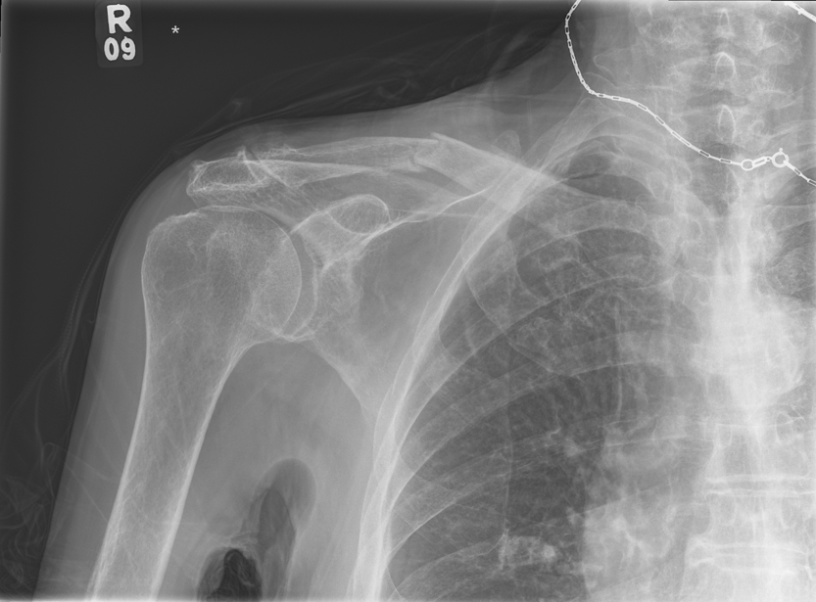

Slide 13
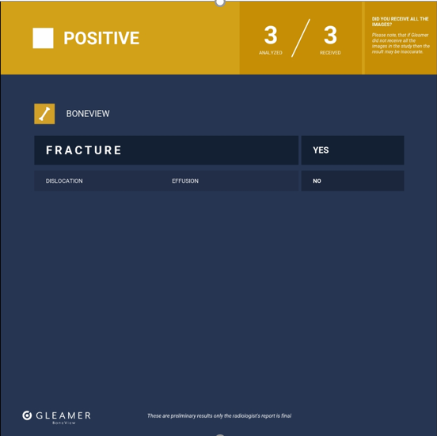

Slide 14
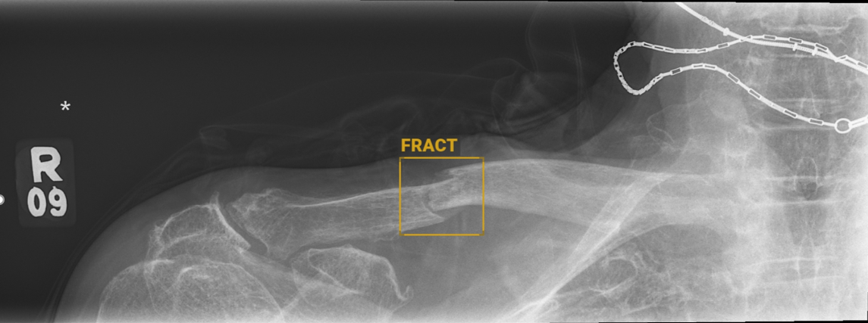

Slide 15
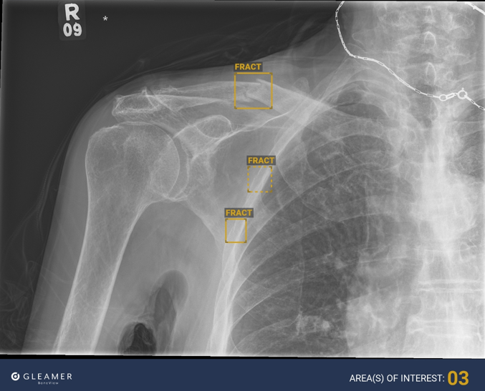

Slide 16

Benefits of AI
Patient Benefits:
  AI is good at flagging up multiple injuries
  Getting it right first time
  Missed fracture rate has reduced from 6.7% to 1.2%
Staff Benefits:
  AI reduces the requirement for a second opinion
  ED performance with AI seems comparable to the Radiology performance
  AI increases confidence levels of junior staff
  Reduced difficult conversations
  Allowing senior staff more time with more difficult cases

Slide 17

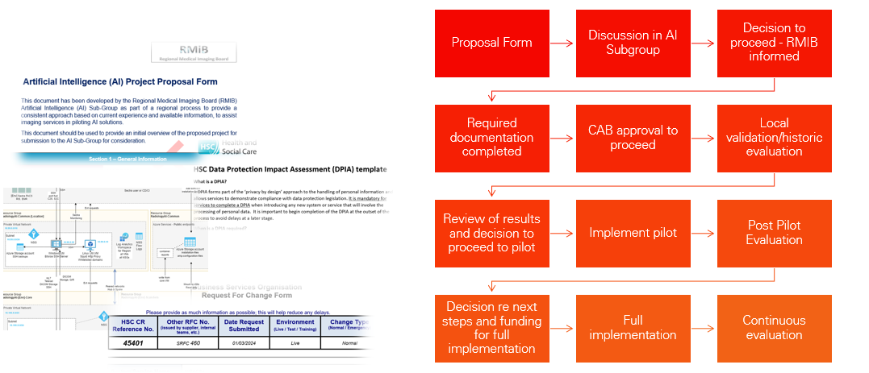
AI Subgroup Regional Process
Notes:
AI Subgroup proposal Form
Contract Change Notification and Impact Assessment (DLS & PaLS)
BSO CR RFC
Cyber Security Summary for Sectra Amplifier Store - Sectra’s summary of the Amplifier Solution that the Boneview Algorithm is hosted on
Sectra white paper detailing ‘Security and privacy for patient data in the Amplifier Services’
NIPACS+ Connectivity Visio for Amplifier Store
Microsoft’s ‘Azure, Dynamics and Online Services’ ISO certificates.
Pen Test ‘Executive Summary Sectra – Amplifier Solution’
Updated NIPACS+ DPIA
Individual Trust DPIAs specific to Boneview (not amplifier, this means a DPIA will be required for each algorithm)
Trust Cyber Questionnaire

Slide 18

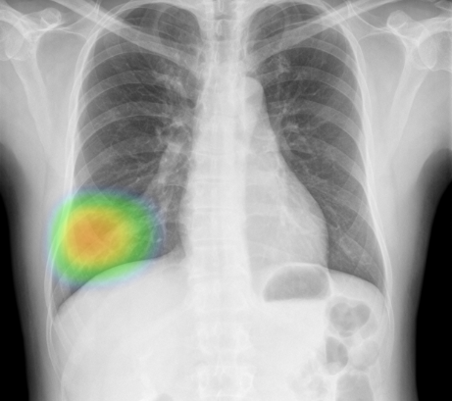
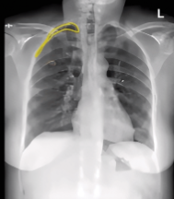
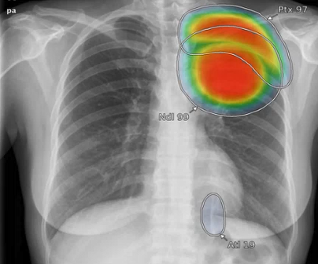
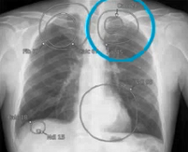

Next Steps – Chest X-Rays
Notes:
Selected tool can detect up to 124 findings

Slide 19

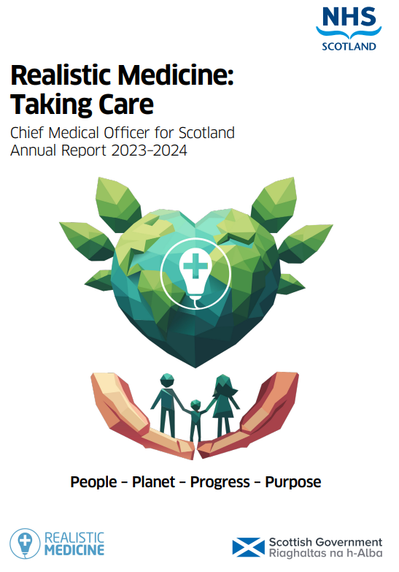
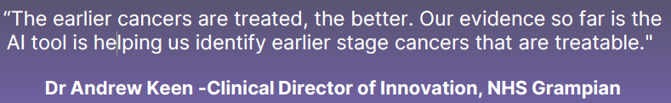
Grampian
CXR AI is speeding up lung cancer diagnosis
(22 days to 10.3 days)
26% Increase in treatable cancers
100% of lung cancer patients meeting 62 day wait (up from 52%)
99.98% Negative Predictive Value
Notes:
NPV indicates the probability that a negative AI prediction ie no disease, is also accurate

Slide 20

Encompass + EPIC
Dragon Ambient eXperience (DAX) Co-Pilot is an AI-powered, voice-enabled solution that reduces the administrative workload of clinicians by automatically documenting patient encounters.
Captures patient interactions accurately and efficiently at the point of care, letting clinicians focus more on patient care.
Reduces documentation time and helps improve patient satisfaction, patient experience, operational efficiency, and financial outcomes.
Has been integrated with the encompass application for 50 consultants in both SEHSCT and BHSCT for a pilot.
In production / use from early Nov 2025.
Epic integrates Generative AI into workflows to boost efficiency and patient care.
Acts as a trusted assistant, summarizing charts and prepping documentation.
Reduces admin tasks, speeds up work and simplifies adoption. Examples: Pre-arrival chart summaries, discharge draft notes.
encompass are currently considering a pilot of this technology, subject to affordability

Slide 21



Business Automation Journey Utilising AI
The Oracle ERP suite for Public Sector comes pre-packaged with a suite of AI components which can enable benefits as outlined below. The Equip Programme will be utilising the AI capability for Document Understanding. This will be used to design and build an automated solution for invoice scanning.
Connect Apps And Data
Automate Processes
Innovate with AI
Automate connectivity to disparate applications and data sources using APIs and RPA robots
Eliminate data silos
Inform decision making
Enhance AI with enterprise data
Support innovation
Automate orchestration of AI services, AI-based decision making, and intelligent document processing
Streamline Processes
Workforce augmentation
Speed adaptability
Increase scalability
Automate complex processes spanning apps, data, trading partners, digital, and human workers
Reduce manual work
Minimise errors
Boost productivity
Empower employees

Slide 22
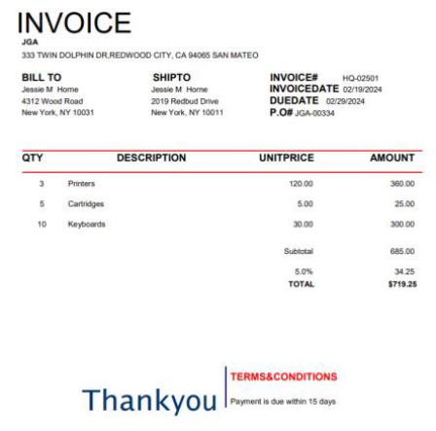
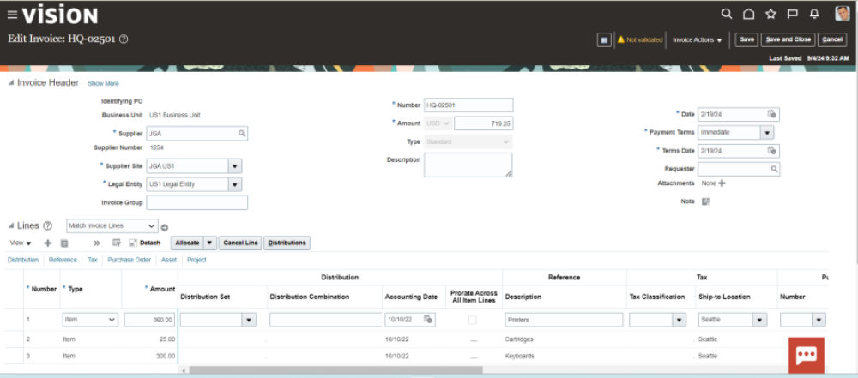

Document Understanding Invoice Creation
Document Understanding can recognise the information contained on supplier invoices and convert these into invoice documents within Oracle. It is capable of recognising invoices in a number of formats can also including handwritten. This enables a high level of automation for invoice creation and invoice matching and reduces the need for manual intervention

Slide 23

Considerations:
Explainability and Transparency
Adoption and Acceptance
Rigorous Testing and Validation
Data Privacy and Security
Ethical Guidelines and Regulations
Accountability
Sustainability / cost
Notes:
Multifaceted approach
Diagnostic Accuracy:
Sensitivity – the ability to correctly identify patients with a disease
Specificity – The ability to correctly identify patients without a disease
Accuracy – Overall % of correct diagnoses, calculated by considering both true positives and true negatives

Slide 24
Regulatory and professional bodies policy / guidance on AI
MHRA: Engage with AI Airlock for pre-market testing, maintain transparency and post-market surveillance. AIaMD - The Regulation of Artificial Intelligence as a Medical Device
NHS: Implement AI governance policies, appoint SIRO and Clinical Safety Officer, ensure ethical deployment.
NMC: Maintain professional judgment, uphold patient safety, and prepare for future AI standards.
NICE: Align with Evidence Standards Framework, CHEERS-AI for economic evaluation, and engage early for guidance.
BMA: Apply 7 principles for AI use, verify MHRA registration for AI tools, involve clinicians and patients in decision-making, monitor AI performance continuously. Principles for artificial intelligence (AI) and its application in healthcare
RCP: Ensure clinician engagement, transparency, and robust evaluation before adoption.
RCR: Follow procurement standards, monitor AI tools in radiology workflows, maintain patient safety.
RCN: Provide training for nurses, ensure ethical use, and support research networks.
GMC: Maintain accountability for AI-assisted decisions, report adverse incidents, and ensure patient safety.
Notes:
Medicines and Healthcare products Regulatory Agency - UK Medical Devices Regulations 2002. AI as a Medical Device
NICE CHEERS-AI Consolidated Health Economic Evaluation Reporting Standards for Interventions That Use Artificial Intelligence (CHEERS-AI). Examine the cost-effectiveness of health interventions, alongside clinical effectiveness and other relevant considerations
BMA 7 Principles
AI must be robustly assessed for safety & efficacy in clinical settings
Governance and regulation to
Staff and patient involvement throughout the development and implementation process is necessary protect patient safety is vital
Staff must be trained on new technologies (initially and continuously) and they must be integrated into workflows
Successful AI requires a robust and functioning NHS to be effective
Existing IT infrastructure and data must be improved
Legal liability must be clarified

Slide 25
Moravec's Paradox
"it is comparatively easy to make computers exhibit adult level performance on intelligence tests or playing checkers, and difficult or impossible to give them the skills of a one-year-old when it comes to perception and mobility".
Task | AI Strengths | Human Strengths
Data Analysis | Excellent at processing large datasets | Limited by time and cognitive load
Empathy and Emotional Support | Cannot genuinely empathize | Strong emotional intelligence and compassion
Documentation | Automates and speeds up record-keeping | May be slower but adds context and nuance
Physical Care (e.g., lifting, positioning) | Limited by robotics and dexterity | Highly skilled in physical tasks
Clinical Judgement | Supports decisions with data | Integrates experience, ethics, and patient cues

Slide 26
AI

Slide 27
AI
IT
Notes:
So as we cut through the hype and move into a new era of healthcare delivery — one powered by data, robotics, and artificial intelligence and IT — it’s easy to wonder what the future holds for nursing & midwifery practice
AI can scan, sort, predict, and process faster than any human.
It can analyse patterns and optimise care in ways that were once unimaginable.
But the Moravec Paradox reminds us of something vital:
What machines find easy — computation, repetition, calculation — are the very things humans find hard.
And what we find easy — empathy, intuition, compassion — are the hardest things for machines to do.
A system can detect pain, but it can’t understand it.
A sensor can monitor a heartbeat, but it can’t feel the courage behind it.
A robot can follow a protocol, but it can’t inspire trust, hope, or healing.
That’s why nursing will never be replaced by AI — it will be elevated by it.
Technology can handle the tasks, but it’s each of you who hold the meaning.
It can manage information, but you bring the humanity.

Slide 28
HUMANITY
AI
IT
Notes:
So as we move forward, don’t see AI as competition — see it as a partner that frees you to do what machines never can:
To connect.
To care.
To heal.
Because no matter how advanced technology becomes, it will always need the heart of a nurse or midwife — the irreplaceable, intuitive, deeply human force that gives healthcare its soul.
So keep leading with your heart, guided by your knowledge, and fearless in the face of change.
Because the future of nursing & midwifery isn’t about choosing between humanity and technology — it’s about showing the world that humanity is our greatest technology.

Slide 29
Thank you for your time
Stephen Beattie
Acting Director of Strategic Planning and Customer Engagement, BSO

